Slide 1

Prepared by Logical Operators
for COSC 3F00
February 27th, 2014

Slide 2
Using Agile Principles
Our highest priority is to satisfy the customer through early and continuous delivery of valuable software
Working software is the primary measure of progress
At regular intervals the team reflects on how to become more effective then tunes and adjusts its behavior accordingly

Slide 3
Planning
Calculated 528 total budgeted hours
Split budget into time-boxed iterations
Prioritized the list of use cases
Pulled highest priority use cases into first iteration
Decided on tools to use

Slide 4
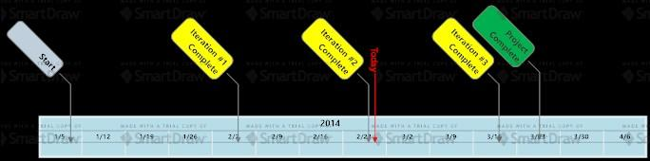
Project Timeline

Slide 5
Iteration #2 Goals
Complete the offline version of the game
Integration with AI
New game as well as save and resume game options

Slide 6
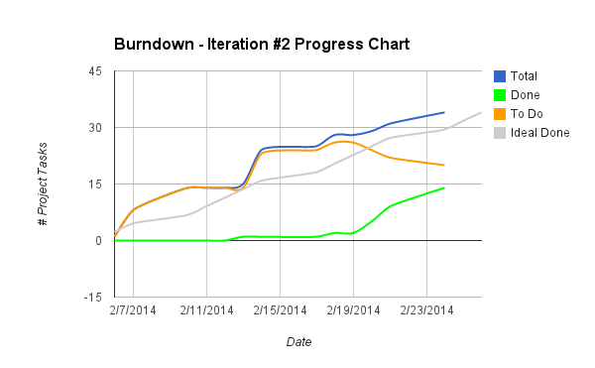

Slide 7
Feature Set | Description | Order | Target Iteration
Game | create a game | 1 | 1
Game | specify game settings (# of players, player color) | 2 | 1
Game | show hotseat game board | 3 | 1
Game | peg animation | 4 | 2
Game | hotseat (offline, no AI) | 5 | 2
Game | close game | 6 | 2
Account | acheivements
Account | anonymous accounts
Account | create an account
Account | edit/delete account

Slide 8
Feature Set | Description | Order | Target Iteration
Account | friends list
Account | game history, rank, etc.
Account | leaderboards/ranking
Account | login with Facebook
Account | logout
Account | message inbox
Account | password reset (via android ... if poss.)
Account | profile page
Admin | admin screen for system analytics
Admin | EULA + COPPA compliance

Slide 9
Feature Set | Description | Order | Target Iteration
Game | 1st-6th place get points
Game | AI takes over when user forfeit
Game | demo mode (to watch AI)
Game | friend request
Game | game playback
Game | in-game chat
Game | multiple games
Game | pegs left to win
Game | play against an AI
Game | player label
Game | set music/fx volume

Slide 10
Feature Set | Description | Order | Target Iteration
Game | timed games
Game | timeless (long) games
Game | toggle show possible moves
Game | turn notification
Help | "help" section
Web | app webpage
 | game lobby

Slide 11
Demonstration

Slide 12
Feedback?
Q&A

Slide 13
Thank you

